Slide 1
Unit Testing in Python
Learn the basics and best practices for unit testing in Python programming.

Slide 2
Introduction
This presentation covers unit testing concepts, frameworks, practices, and methodologies using Python. It aims to equip you with the knowledge and tools to implement effective unit tests in your projects.

Slide 3
01
Introduction to Unit Testing

Slide 4

What is Unit Testing?
Unit testing is a software testing technique where individual components of a software are tested in isolation. It helps to ensure that each part of the code functions correctly and allows for early detection of bugs.

Slide 5
Importance of Unit Testing
Unit testing provides numerous benefits, including improving code quality, facilitating changes, preventing regression bugs, and creating better documentation. It helps ensure that software meets its design requirements and functions properly.

Slide 6
Unit Testing in Software Development Life Cycle
Unit testing is a crucial part of the software development life cycle (SDLC). It is typically performed after coding and before integration with other components, providing immediate feedback to developers on their code accuracy and reliability.

Slide 7
02
Unit Testing Frameworks

Slide 8
Popular Frameworks in Python
Several frameworks are commonly used for unit testing in Python, including unittest, pytest, and nose. Each framework has unique features and advantages that cater to different testing needs.

Slide 9
Setting Up a Testing Framework
Setting up a testing framework involves installing the chosen framework, organizing your tests within a project structure, and writing initial test cases. Proper setup ensures that tests can be easily run and maintained over time.

Slide 10
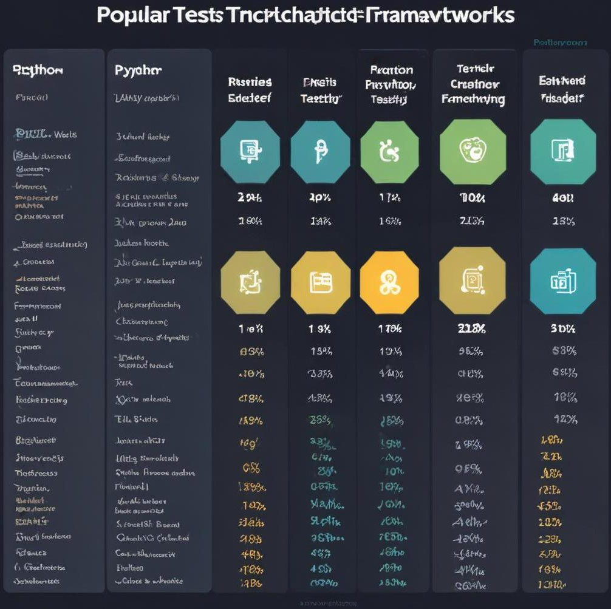
Comparing Different Testing Frameworks
When selecting a testing framework, consider factors such as ease of use, community support, feature sets, and compatibility with other tools. Understanding the differences can help you choose the right framework for your projects.

Slide 11
Writing Unit Tests
03

Slide 12
Creating Your First Unit Test
To create your first unit test in Python, start by importing the testing framework. Define a function that contains the test logic, using assertions to check expected outcomes. Run the test to ensure it passes, adjusting your code as needed.

Slide 13
Test Cases and Test Suites
A test case is a single unit test that verifies a specific behavior, while a test suite is a collection of test cases organized to run together. This organization helps manage tests efficiently and ensures comprehensive test coverage.

Slide 14
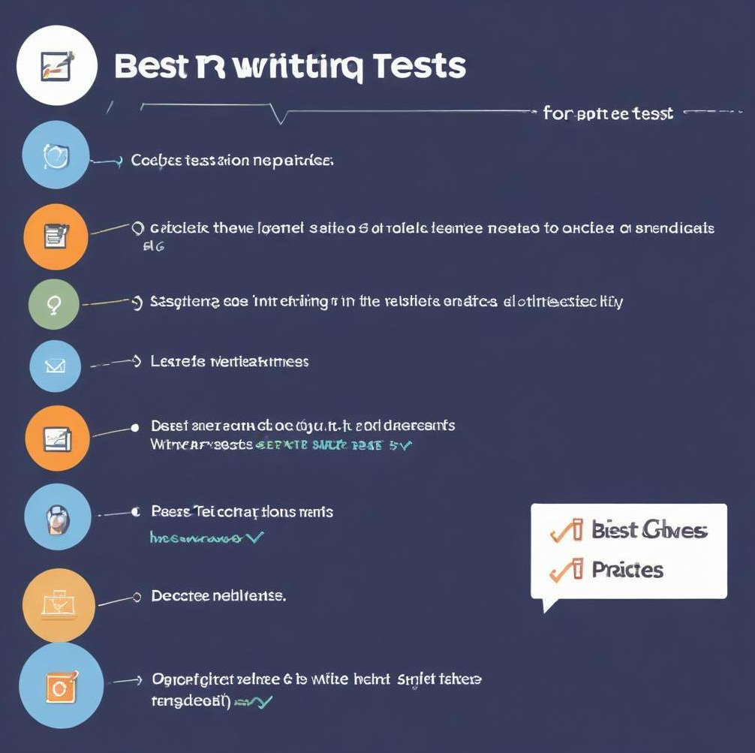
Best Practices for Writing Unit Tests
Adopt best practices by keeping tests independent, writing clear and descriptive test names, and using setup/teardown methods for shared logic. Additionally, aim for a high level of coverage while focusing on functionality rather than implementation details.

Slide 15
04
Mocking and Patching

Slide 16
Understanding Mocking
Mocking is a technique used to simulate the behavior of complex objects within tests. This allows you to isolate the unit being tested, ensuring that it behaves correctly without needing the complete environment or dependencies to be present.

Slide 17

When to Use Mocking
Use mocking when your code interacts with external systems, such as APIs or databases, that are not necessary for the specific unit test. It reduces dependencies and enhances test reliability, making tests faster and more stable.

Slide 18
Using Patching in Tests
Patching is a specific type of mocking that allows you to temporarily replace a method or object. It is often used in tests to override specific functionalities, making it easier to isolate and verify behavior in your tests.

Slide 19
05
Running and Reporting Tests

Slide 20
Executing Tests in Python
To execute tests in Python, use the command line to run your test framework, specifying the test directory or file. Most frameworks also provide options to run tests automatically and generate output for successful and failed tests.

Slide 21
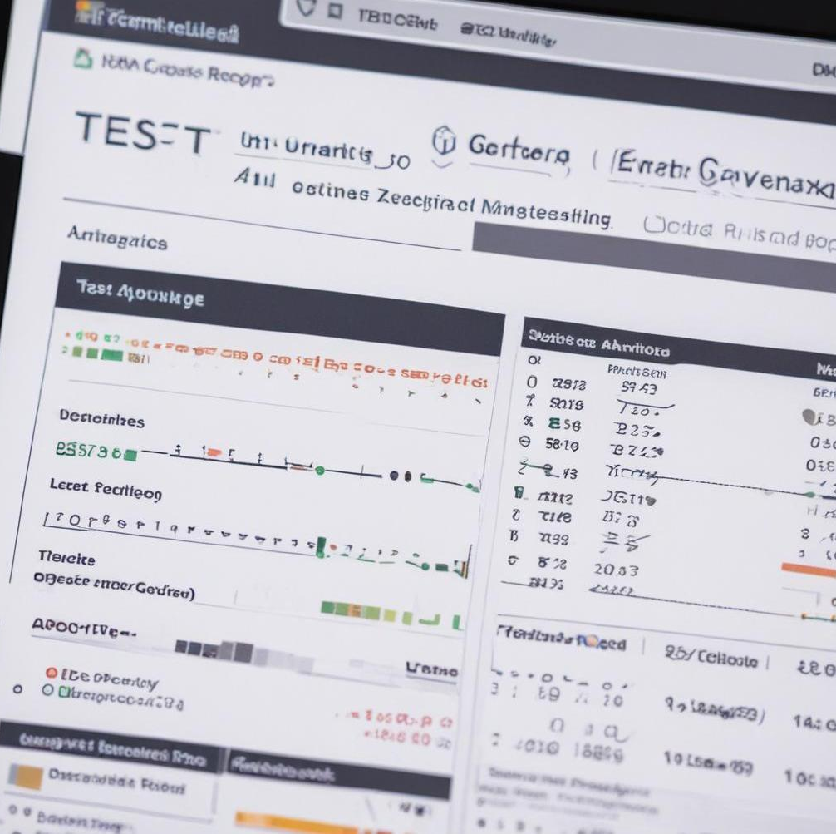
Generating Test Reports
After executing tests, generating reports provides insight into test outcomes and coverage. Most frameworks can automatically create detailed reports that summarize successes and failures, allowing for quick analysis and action.

Slide 22
Continuous Integration and Unit Testing
Integrating unit tests into a continuous integration pipeline ensures that tests run automatically with each code change. This helps catch issues early and promotes collaboration, allowing teams to maintain software quality at scale.

Slide 23
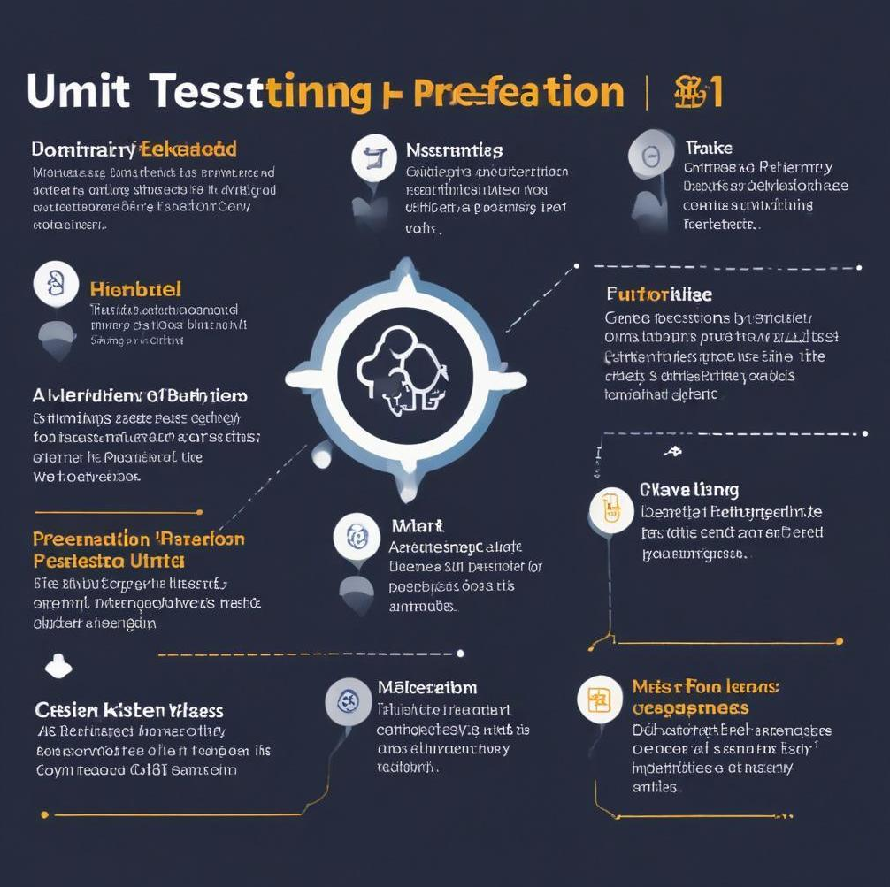
Conclusions
This presentation highlighted the importance of unit testing in Python, covering frameworks, best practices, and techniques such as mocking and patching. Implementing unit tests effectively ensures code quality and enhances the development process.

Slide 24
Thank you!
Do you have any questions?

